Slide 1
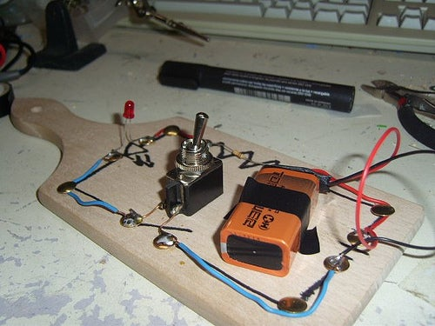
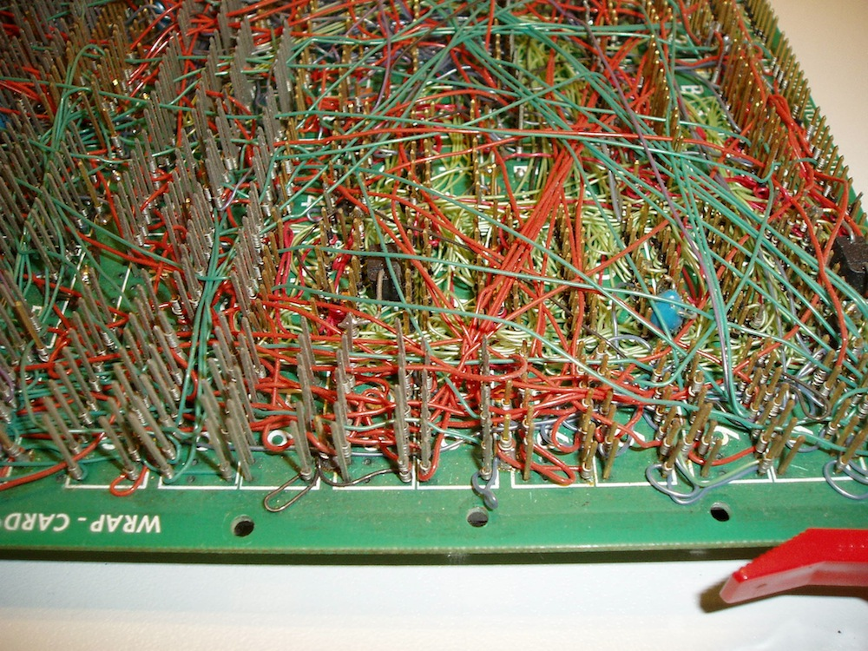
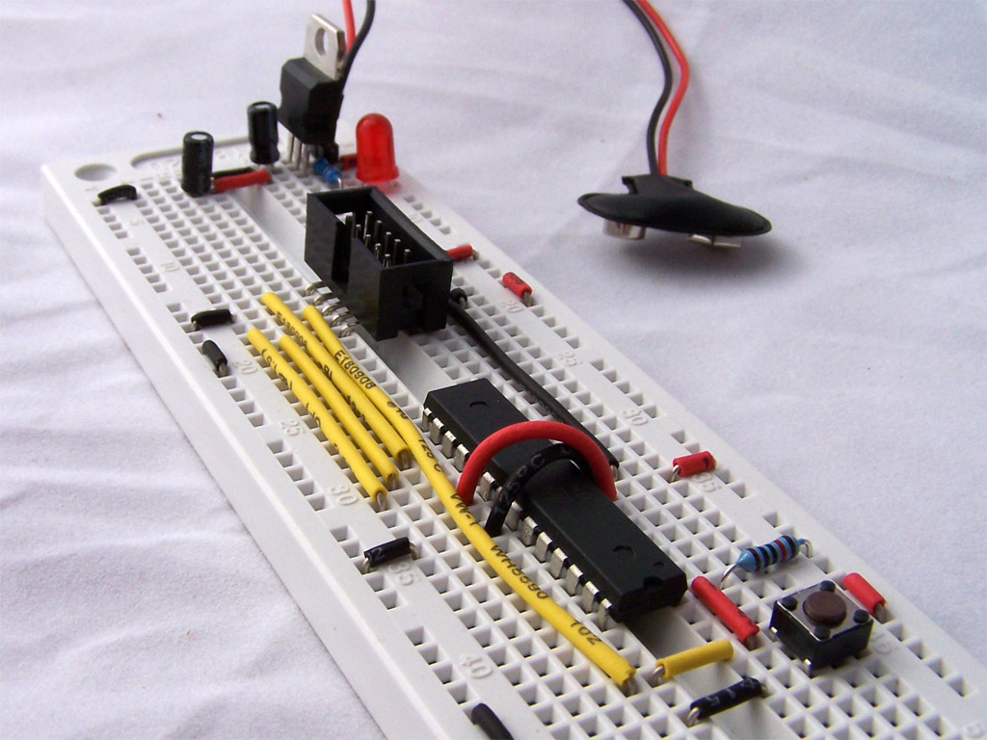
Wire wrapping circa
Wire wrapping circa
Wire wrapping involved wrapping wires around conductive posts attached to perfboards
Wire wrapping involved wrapping wires around conductive posts attached to perfboards
Breadboards simplify this by having some wiring “built-in,” which are accessed via holes.

Slide 2
Literal breadboarding
Wire wrapping circa
Breadboarding!

Slide 3
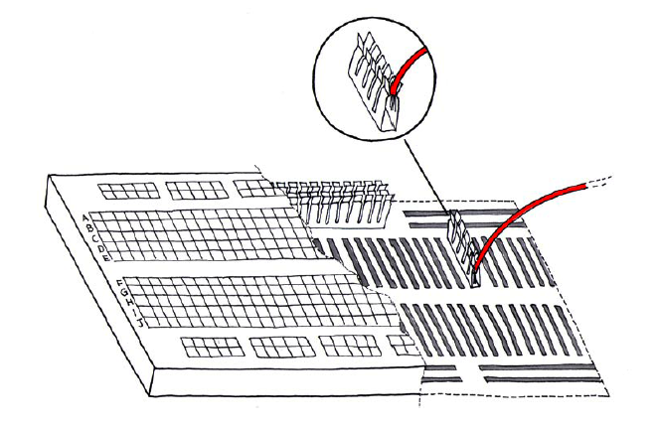
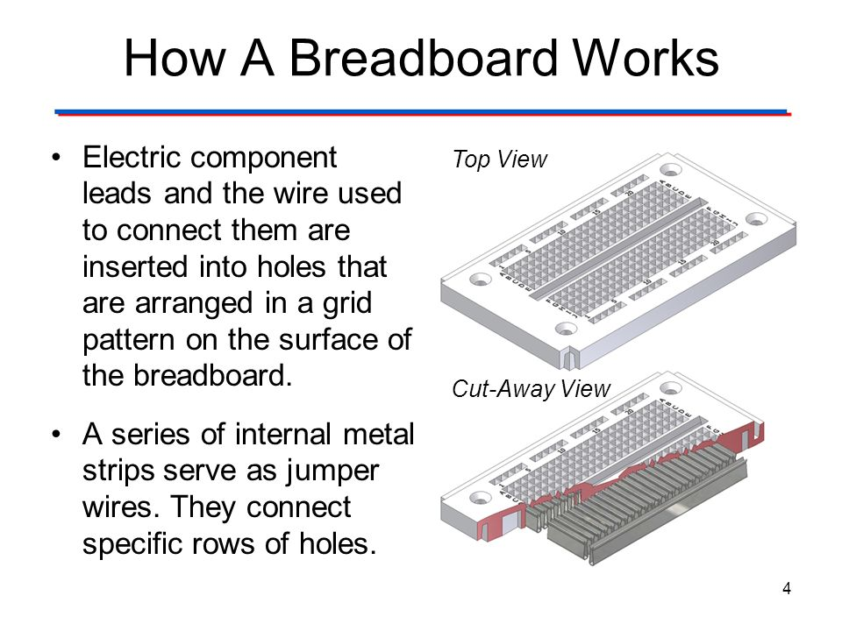
Top View
Cutaway view 1
Cutaway view 2
Each of these columns are independent nodes
This power rail is one giant wire (or node)
This breadboard has two power rails on each side

Slide 4
Notes:
https://slideplayer.com/slide/7059660/

Slide 5
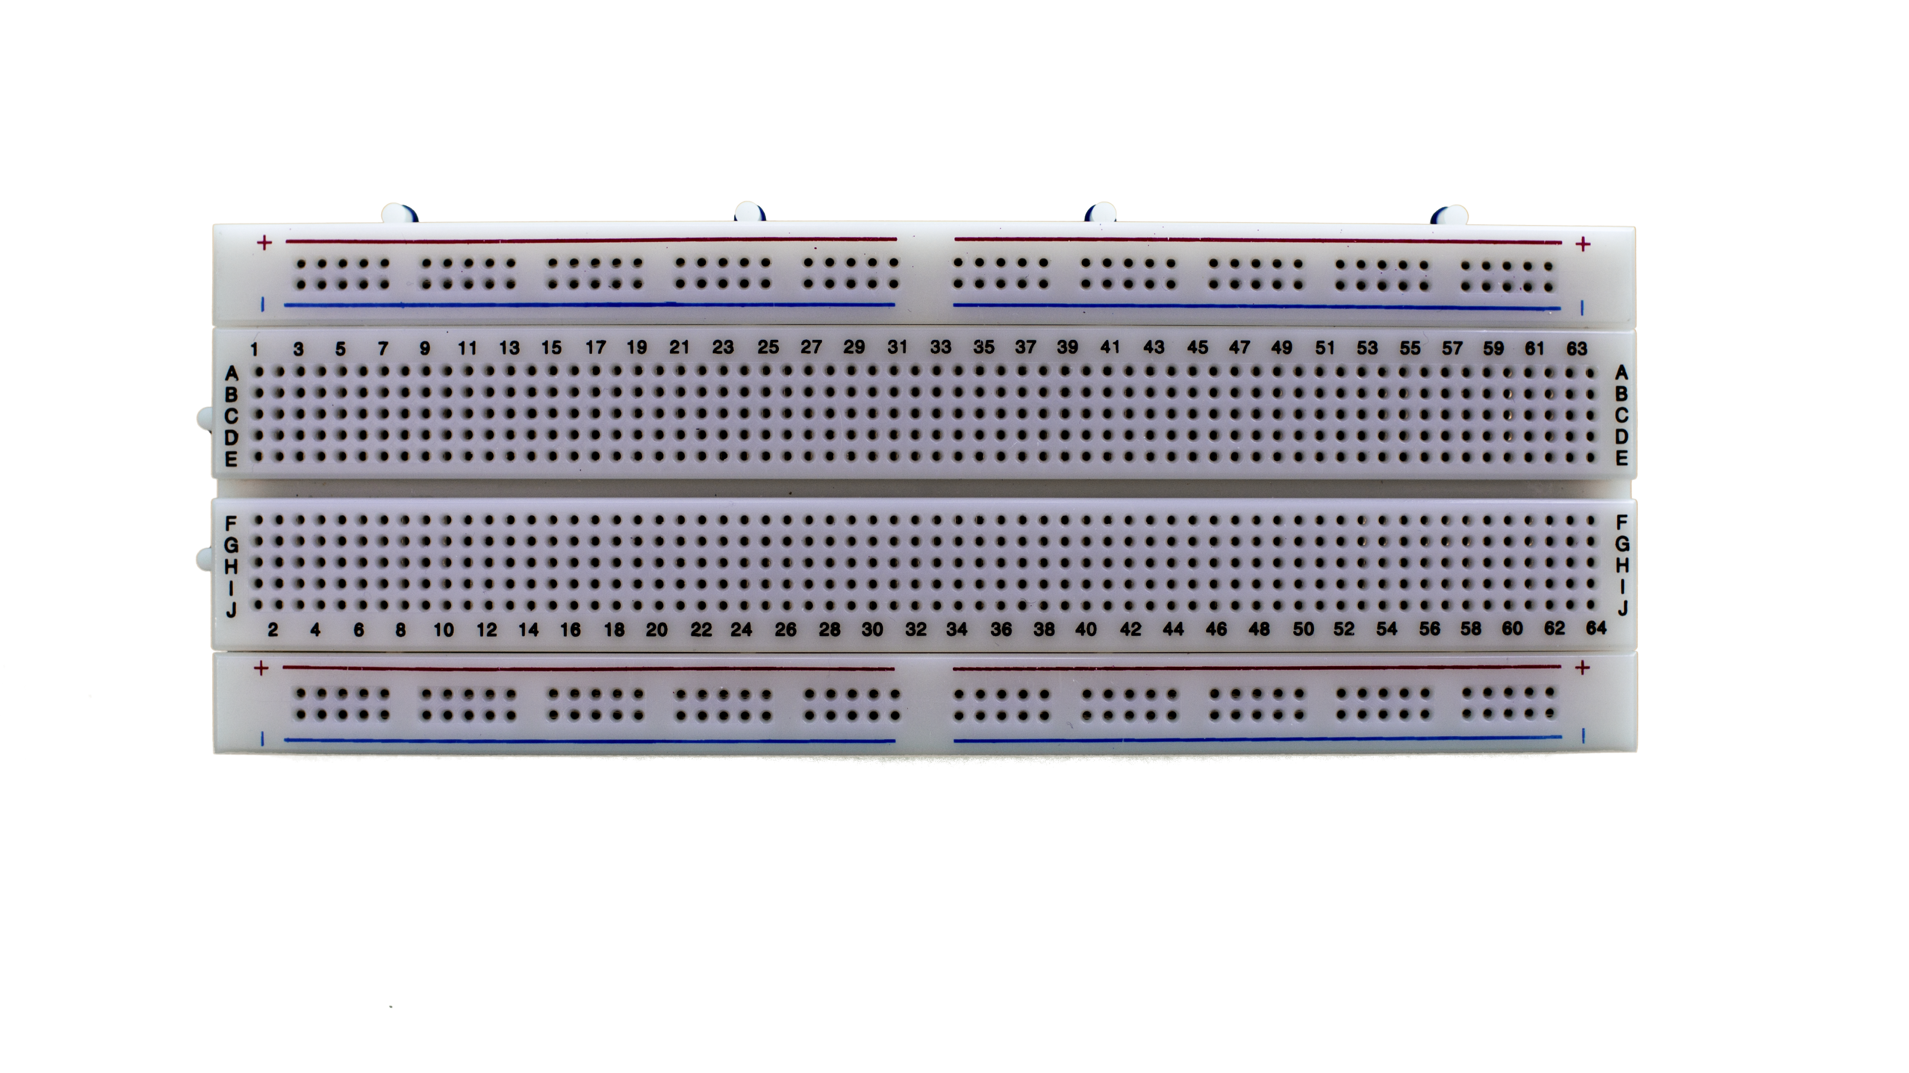
Notes:
https://www.baldengineer.com/electronics-introduction-to-breadboards.html

Slide 6
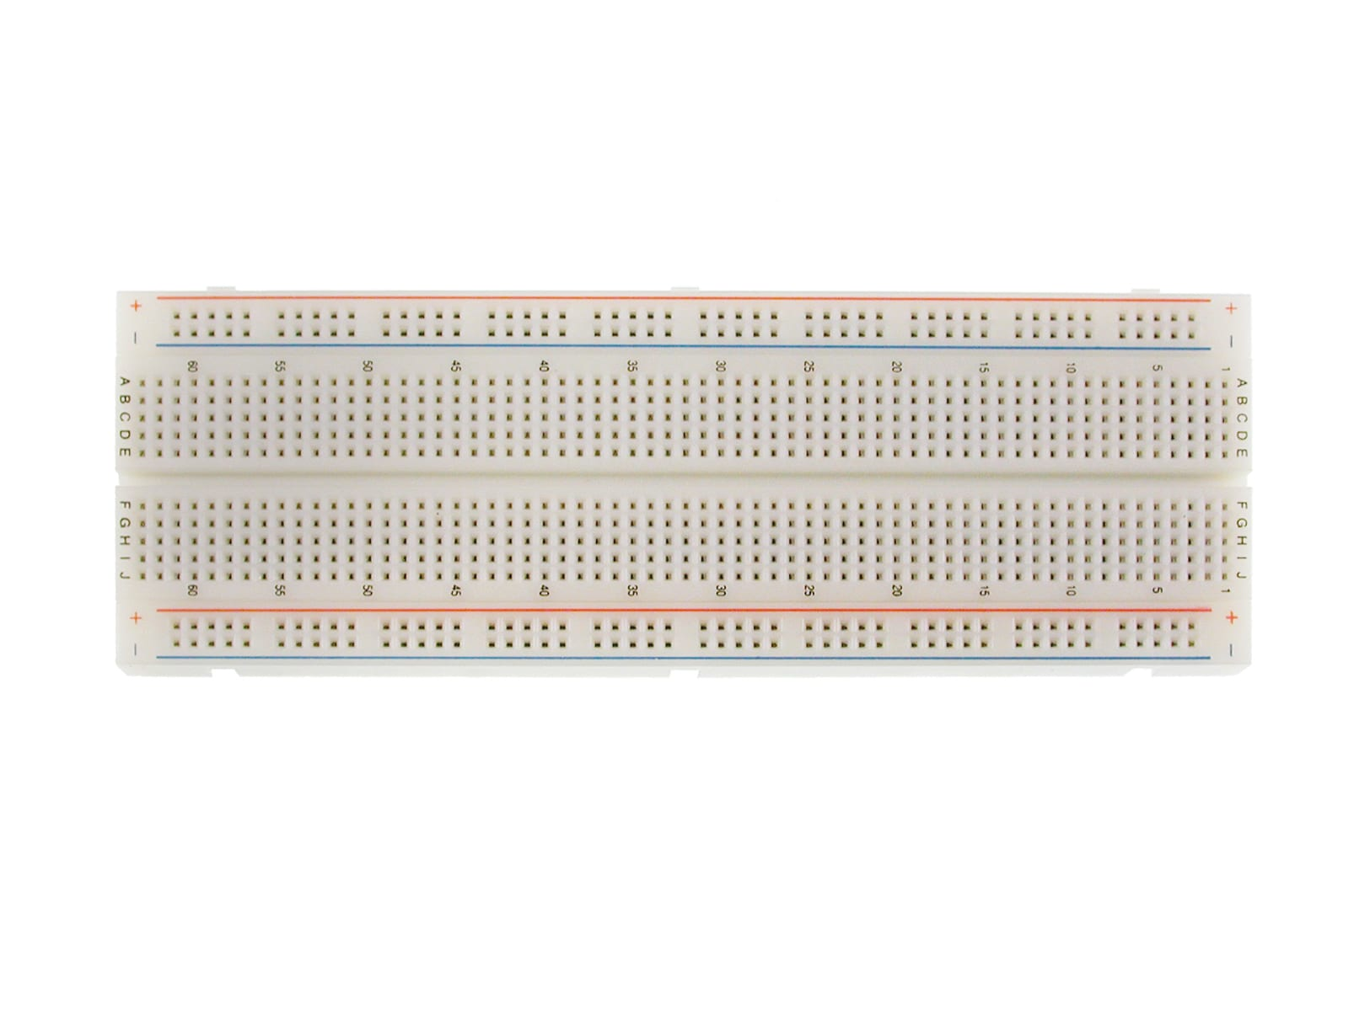
Notes:
https://solarbotics.com/product/21020/

Slide 7
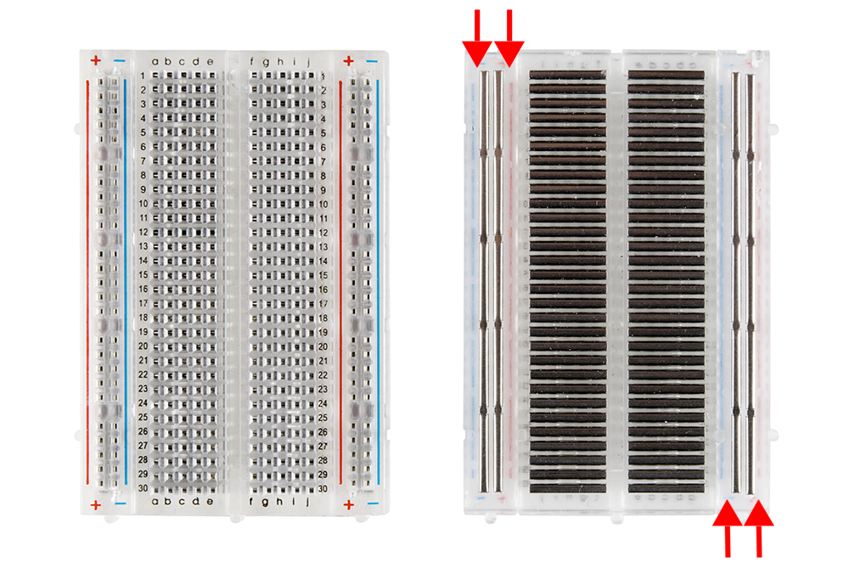
How do breadboards work?
breadboards
Wire 2: Similarly, all of these holes are hooked together (forming a new wire)
Wire 1: All of these holes are hooked together (to the same wire)
Row set 1
wire1
Each row wired together
wire2
Column set 1
Each column wired together
Column set 2
Each column wired together
Row set 2
wire3
Each row wired together
wire4
Inside Breadboard
Viewed from the bottom
Importantly, wires do not cross this channel. So, the other side of a breadboard provides additional wiring

Slide 8
Breadboard tip 1: Use rails for voltage supply & Ground
breadboards
Typically we hook up Vs (our positive voltage source) here
Row set 1
Each row wired together
And we hook up GND (ground) here.
Column set 1
Each column wired together
This wiring configuration just makes things easier.
In fact, this part of the breadboard is often called “power rails”
Column set 2
Each column wired together
Row set 2
Each row wired together

Slide 9
Typically we hook up Vs (our positive voltage source) here
Row set 1
Each row wired together
And we hook up GND (ground) here.
Column set 1
Each column wired together
This wiring configuration just makes things easier.
In fact, this part of the breadboard is often called “power rails”
Column set 2
Each column wired together
Row set 2
Each row wired together

Slide 10
Notes:
http://www.captaincredible.com/abc/?page_id=92

Slide 11
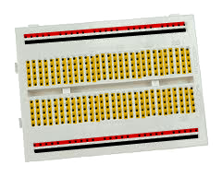

Slide 12
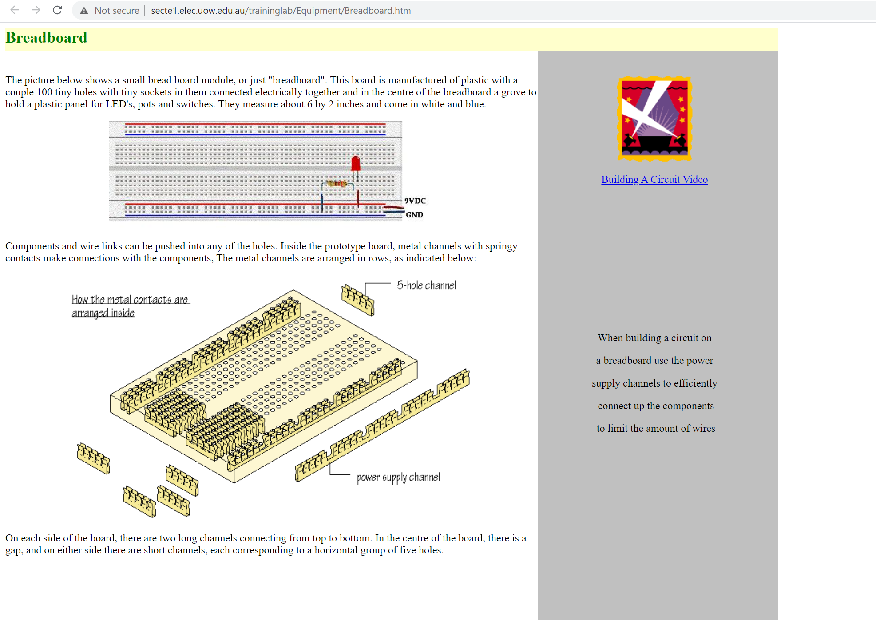
Notes:
http://secte1.elec.uow.edu.au/traininglab/Equipment/Breadboard.htm

Slide 13
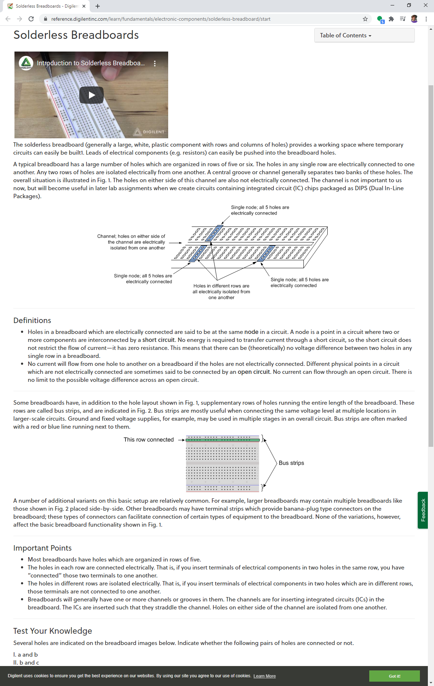

Slide 14
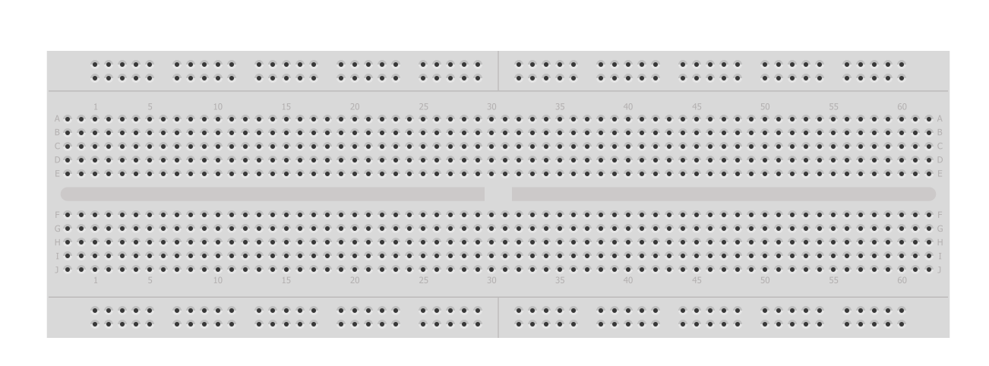
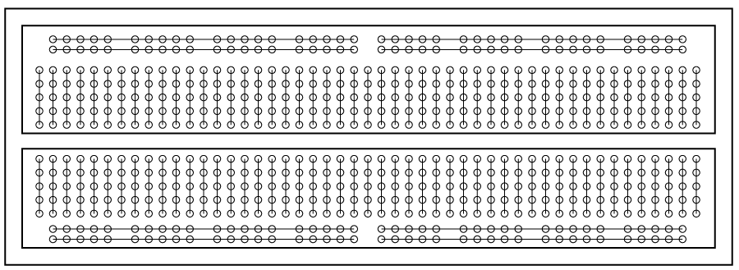

Slide 15
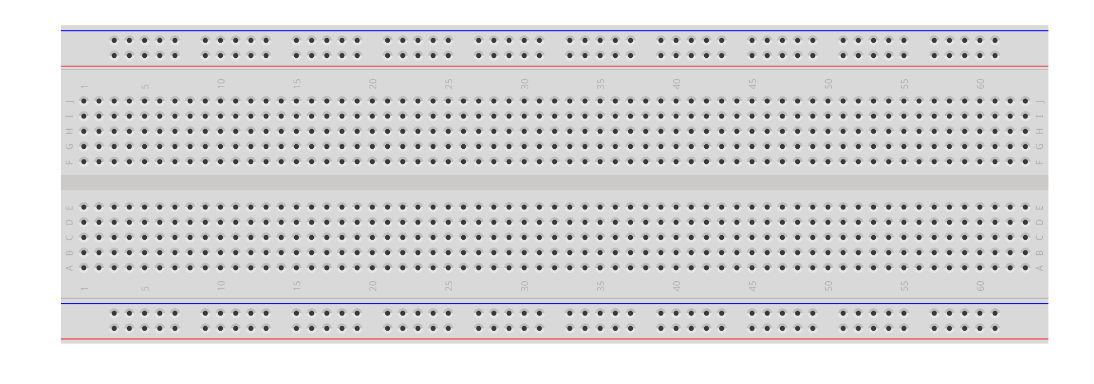

Slide 17
A full-sized breadboard
Breadboard with pre-wired connections marked

Slide 18
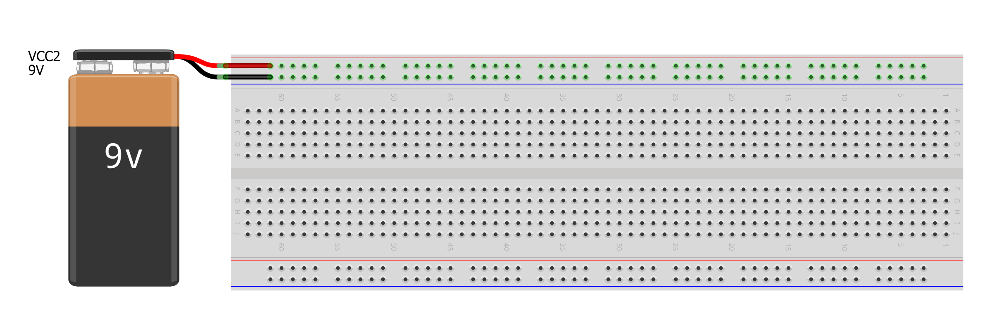
Tip: Use Power rails
Typically, we hook up Vs (our positive voltage source) here
And we hook up GND (ground) here.

Slide 19
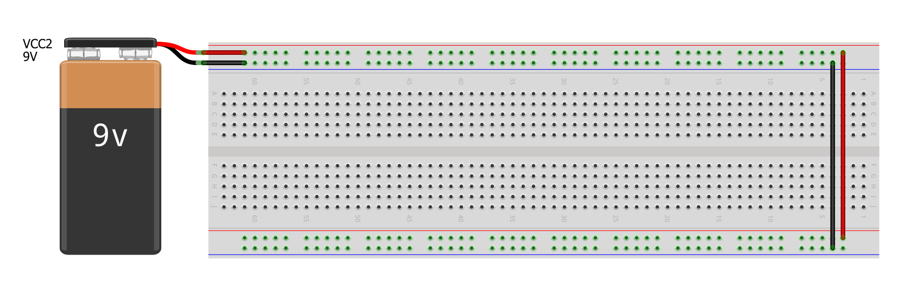
Tip: Link power rails across board
It’s common to link the two sets of power rails by adding jumper wires like this.

Slide 20
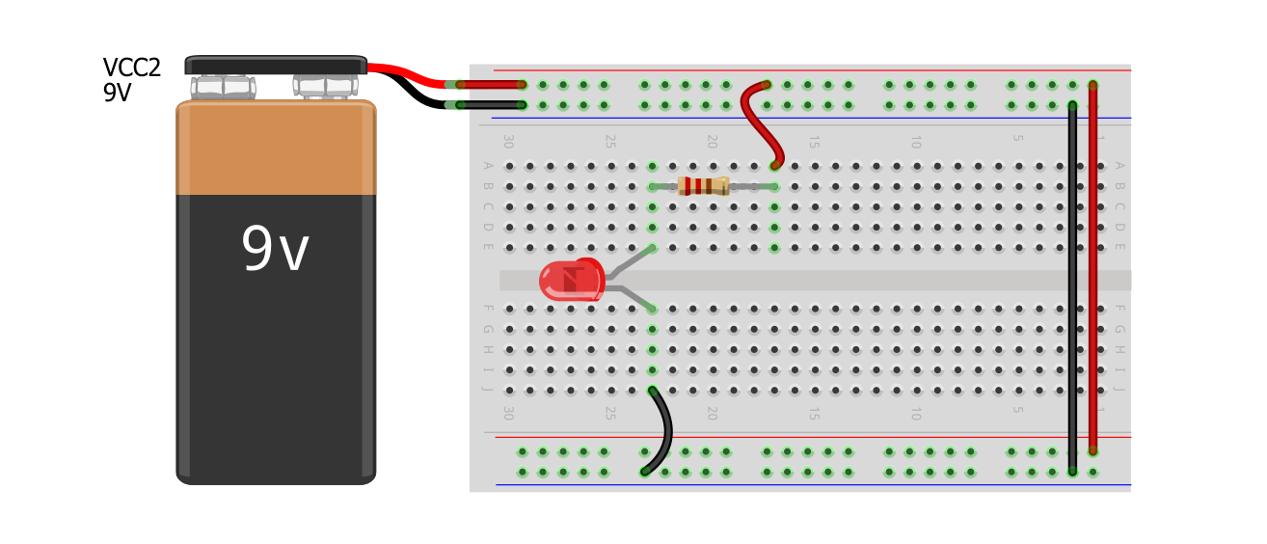
Tip: Use Wire colors to convey meaning
It’s helpful to use wire colors to indicate connections.
I use red wire for anything that touches Vs and black wire for anything that touches GND.
This helps with debugging and keeps your circuits clean.

Slide 21
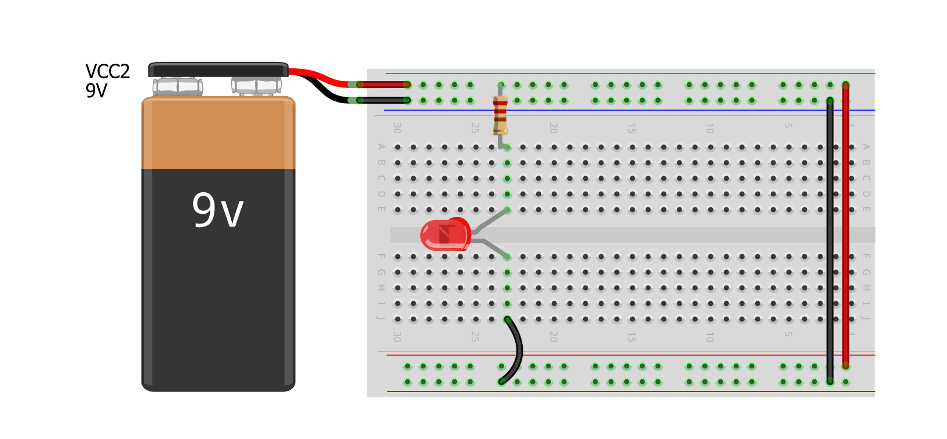

Slide 29
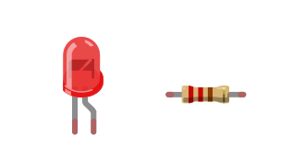
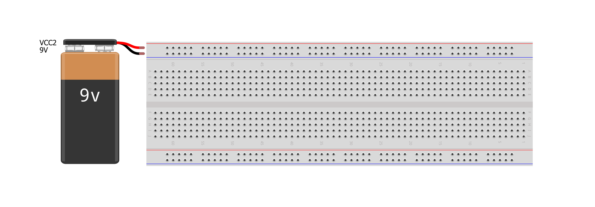
Let’s breadboard a simple LED circuit!
+
Battery
Resistor
R
-
LED
(light-emitting diode)

Slide 30
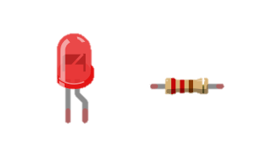
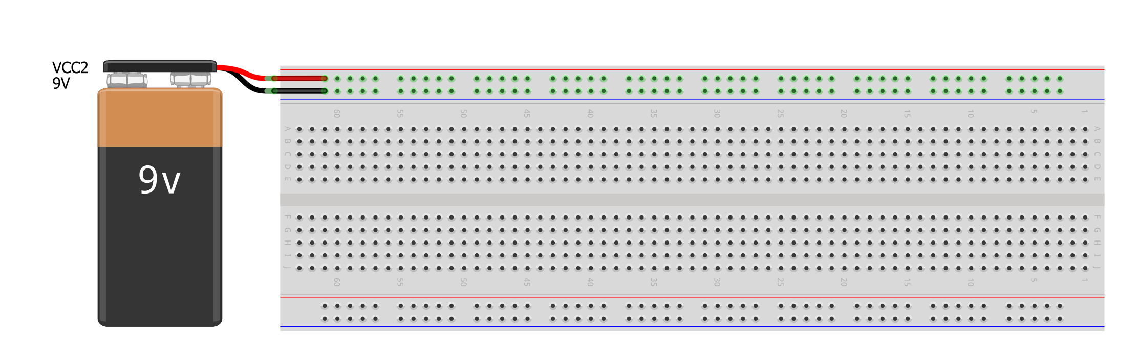
Node A
Node B
+
Battery
Resistor
R
-
LED
(light-emitting diode)

Slide 31
Step 1: Connect voltage source
Node A
Node B
+
Battery
-

Slide 32

Step 2: add the resistor
Node A
Node B
+
Resistor
R
Battery
Node C
-

Slide 33
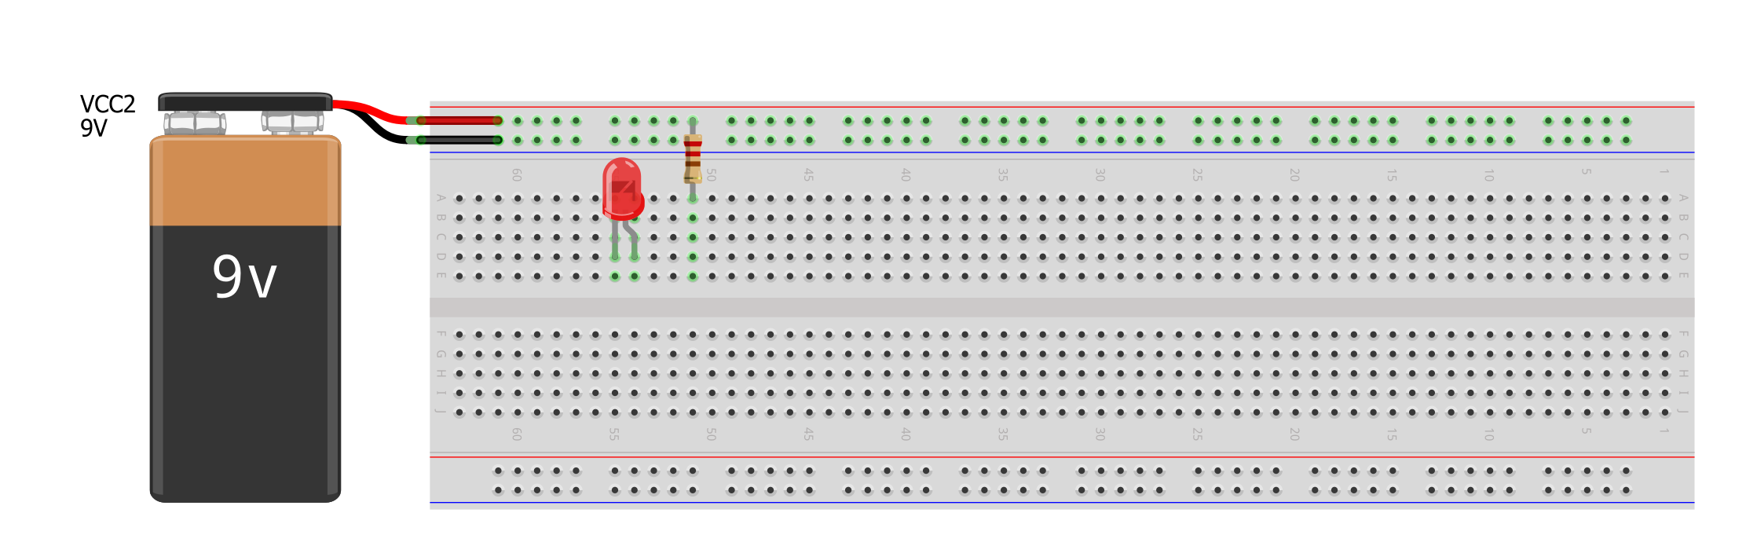
Step 3: add the led (but not yet connected)
Node A
Node B
+
Resistor
Node C
Battery
-
Node E
Node D
LED

Slide 34
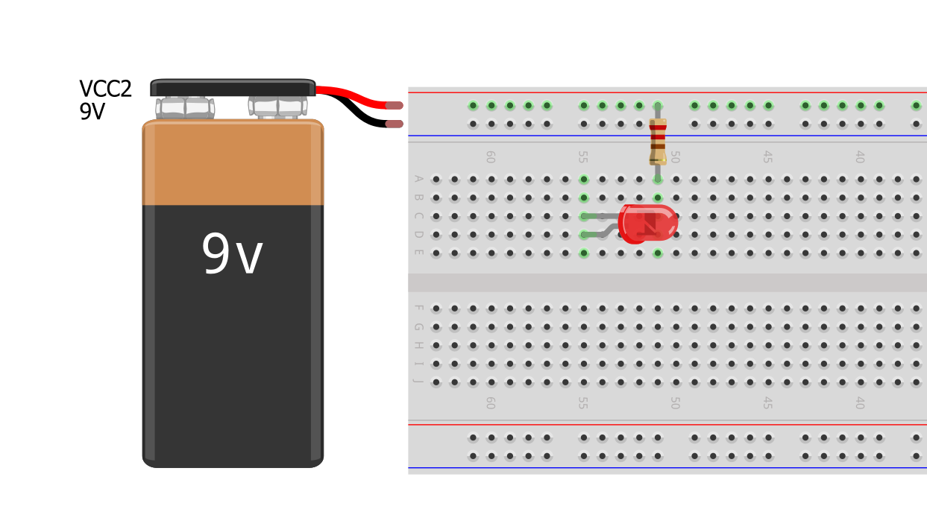
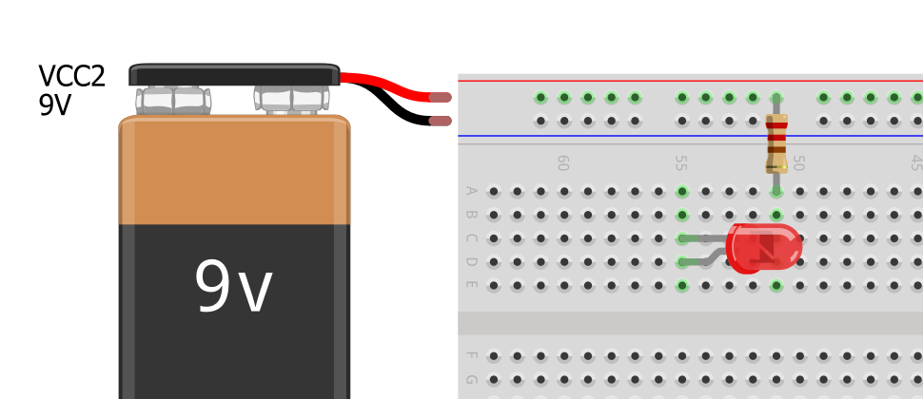
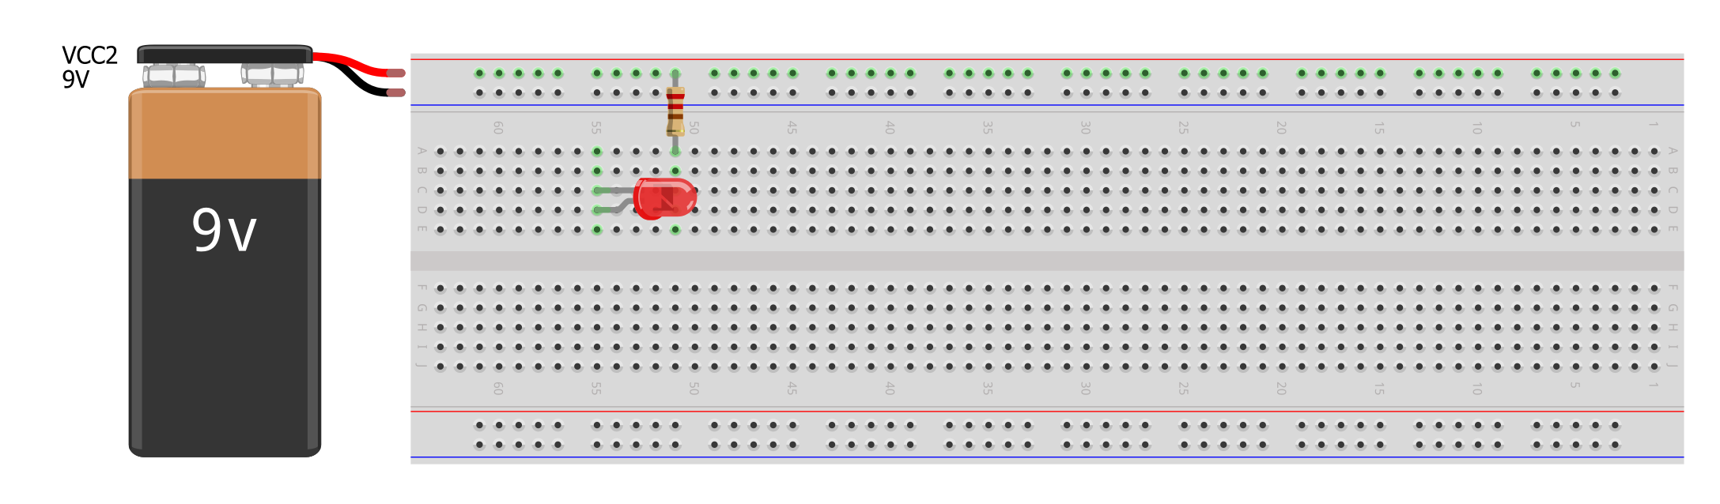

Do not place a component vertically in a column
Placing the LED in this orientation such that both legs are in the same column would be like wiring both legs together. Don’t do this!

Slide 35

Step 4: connect led anode leg
Node A
Node B
+
Resistor
Battery
Node C
(connected via a jumper wire)
-
Node E
LED

Slide 36

Step 5: add wire to led cathode leg
Node A
Node B
+
Resistor
Battery
Node E (connected via a jumper wire)
Node C
(connected via a jumper wire)
-
LED

Slide 37

Step 6: connect cathode leg to ground and our circuit is complete!
Node A
Node B
+
Resistor
Battery
Node B (connected to GND)
Node C
(connected via a jumper wire)
-
LED

Slide 38
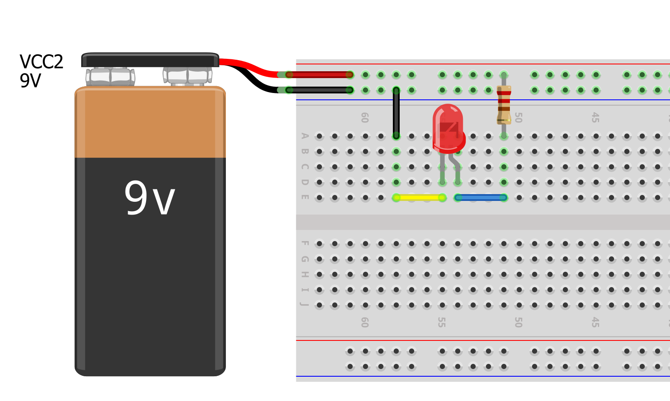
Switch
+
Battery
Resistor
R = 470Ω
-

Slide 39
Switch
+
Battery
Resistor
R = 470Ω
-

Slide 40
Switch
+
Battery
Resistor
R = 470Ω
-

Slide 41
Simple breadboarded led circuit
Underlying circuit and connections
Current flow through breadboard

Slide 42
Switch
+
Battery
Resistor
R = 470Ω
-

Slide 43
Functionally equivalent LED circuit
Current flow through breadboard

Slide 44
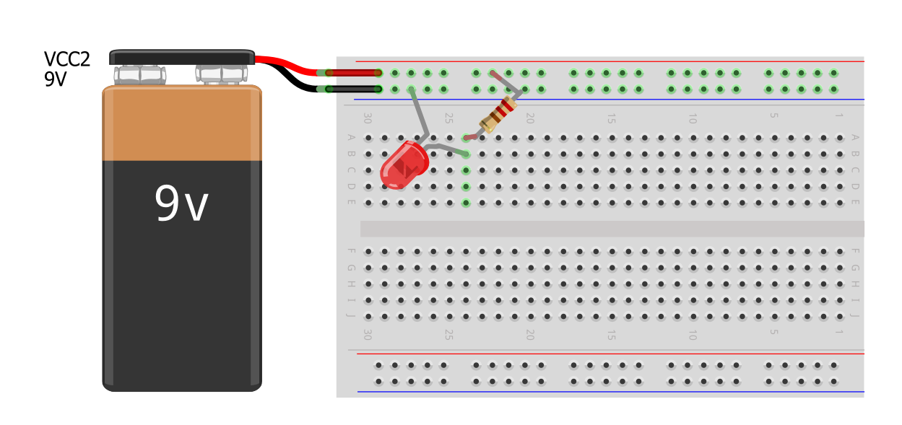
Functionally equivalent LED circuit
Current flow through breadboard

Slide 45
What is a breadboard?
breadboards
Breadboards are quick way of wiring and prototyping circuits
Wire wrapping circa ~1960
Breadboarding
Wire wrapping involved wrapping wires around conductive posts attached to perfboards
Breadboards simplify this by having some wiring “built-in,” which are accessed via holes.
Source: https://learn.sparkfun.com/tutorials/how-to-use-a-breadboard
Notes:
Source: https://learn.sparkfun.com/tutorials/how-to-use-a-breadboard
If you wanted to build a circuit prior to the 1960s, chances are you would have used a technique called wire-wrap. Wire wrap is a process that involves wrapping wires around conductive posts attached to a perfboard (a.k.a. a protoboard). As you can see, the process can get rather complex very quickly.Although this method is still used today, there is something that makes prototyping much easier, breadboards!
Source for breadboard: Source: http://d32zx1or0t1x0y.cloudfront.net/2009/07/atmega8_breadboard_1_lrg.jpg

Slide 46
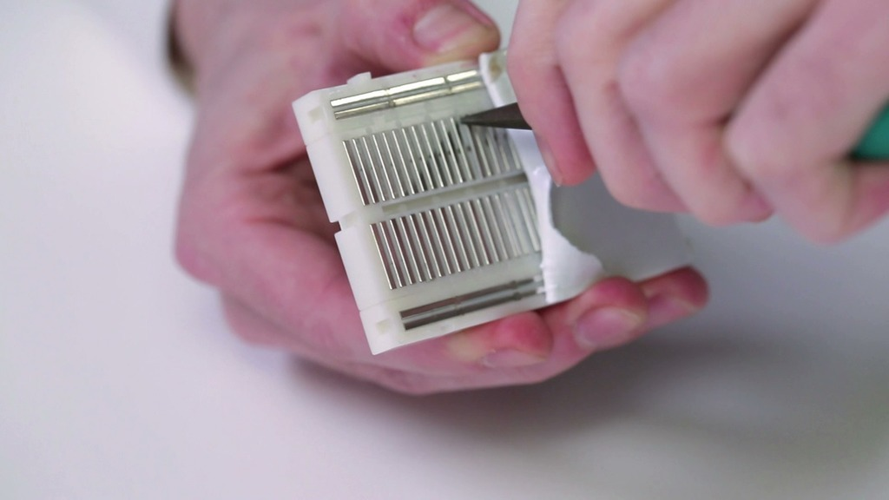
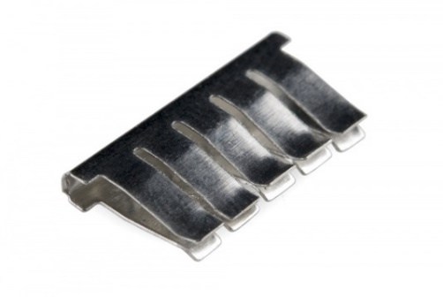
How do breadboards work?
breadboards
Breadboards are simply pre-wired boards. They are always a bit confusing at first. It will just take a bit of experience to get comfortable!
Top of Breadboard
Viewed from the top
Inside Breadboard
Viewed from the bottom

Slide 47
How do breadboards work?
breadboards
Wire 2: Similarly, all of these holes are hooked together (forming a new wire)
Wire 1: All of these holes are hooked together (to the same wire)
Row set 1
wire1
Each row wired together
wire2
Column set 1
Each column wired together
Column set 2
Each column wired together
Row set 2
wire3
Each row wired together
wire4
Inside Breadboard
Viewed from the bottom
Importantly, wires do not cross this channel. So, the other side of a breadboard provides additional wiring

Slide 48
Breadboard tip 1: Use rails for voltage supply & Ground
breadboards
Typically we hook up Vs (our positive voltage source) here
Row set 1
Each row wired together
And we hook up GND (ground) here.
Column set 1
Each column wired together
This wiring configuration just makes things easier.
In fact, this part of the breadboard is often called “power rails”
Column set 2
Each column wired together
Row set 2
Each row wired together

Slide 49
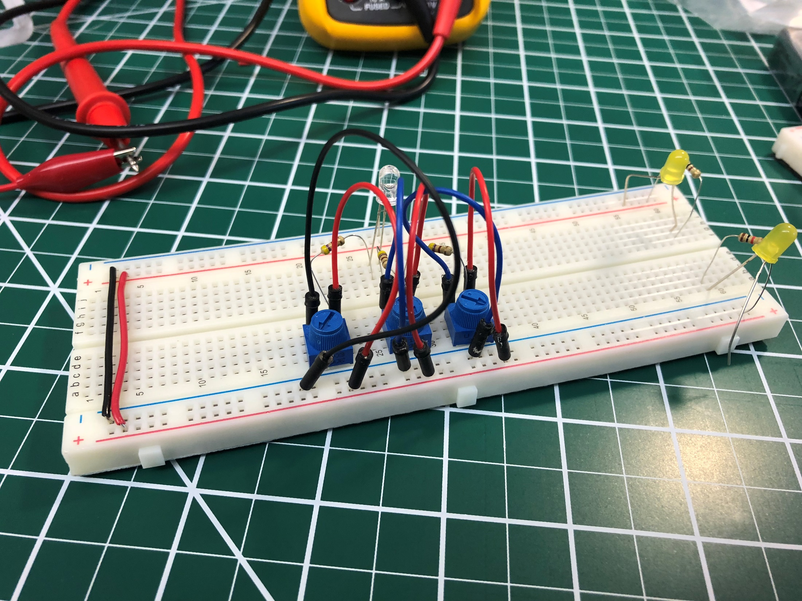
breadboards
Breadboard tip 2: connect power rails with jumper wire
Red jumper wire connects the two “+” rails
Black jumper wire connects the two “-” rails
Notes:
Photo by Jon Froehlich

Slide 50
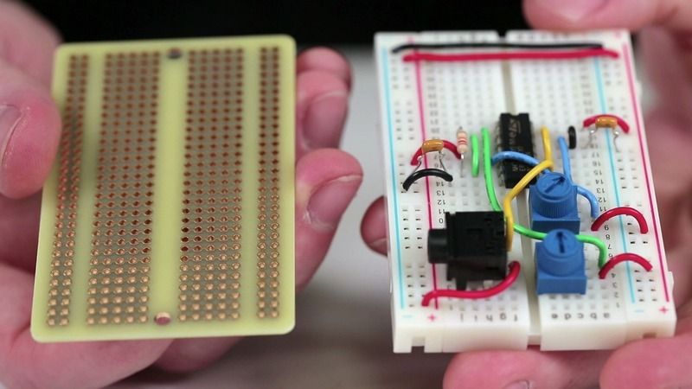
Breadboard tip 3: Use wire color to mean something
breadboards
Use other wire colors to indicate other meaning
Only use black wire for wires that connect to GND
Only use red wire for wires that connect to positive voltage source

Slide 51
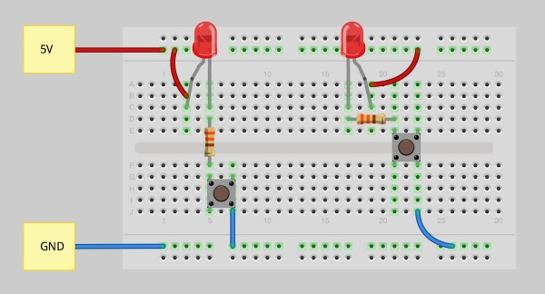
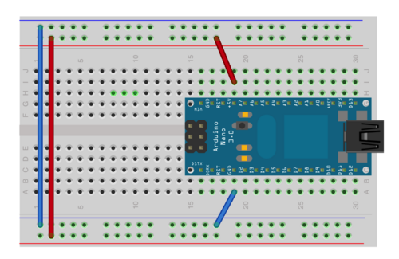
Breadboard tip 4: defensive breadboarding
breadboards
Some choose to only connect power on one side of the breadboard and ground on the other to reduce the chance of accidentally plugging a wire into the wrong socket and shorting out a circuit.
Notice how the 5V and GND rails are only connected on opposite sides of the breadboard. This is to limit stupid mistakes!
Source: https://learn.adafruit.com/assets/17394, https://learn.sparkfun.com/tutorials/how-to-use-a-breadboard

Slide 52
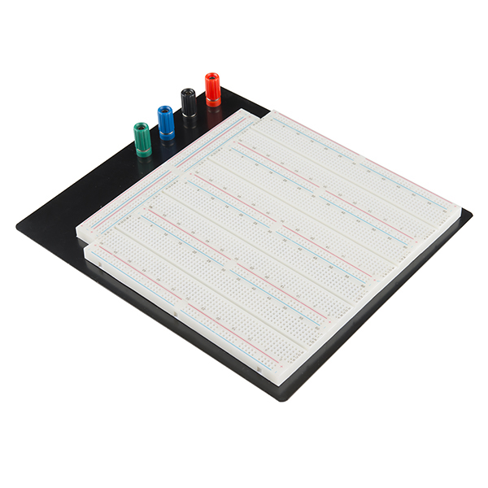
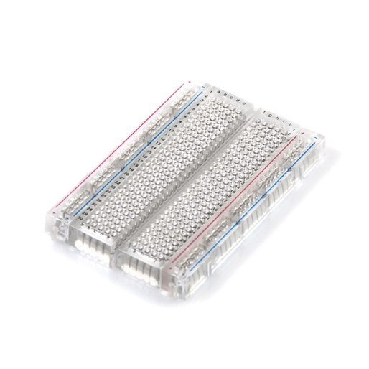
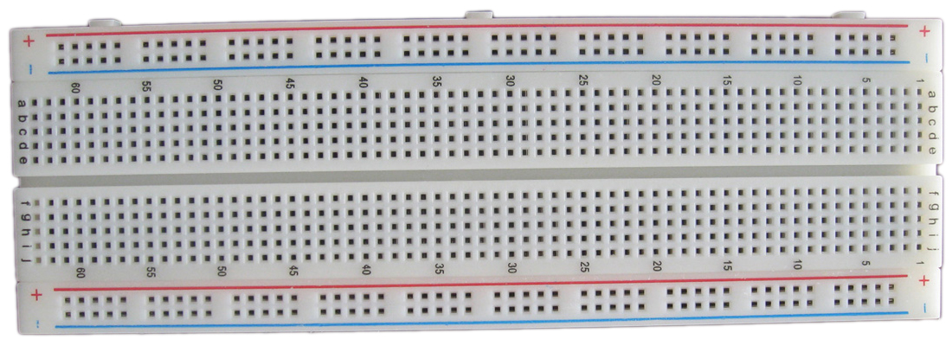
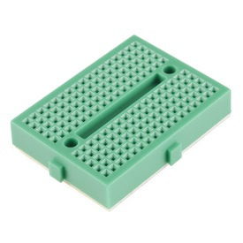
Lots of different breadboard sizes
breadboards
Which breadboards do you have in your Arduino kits?

Slide 53
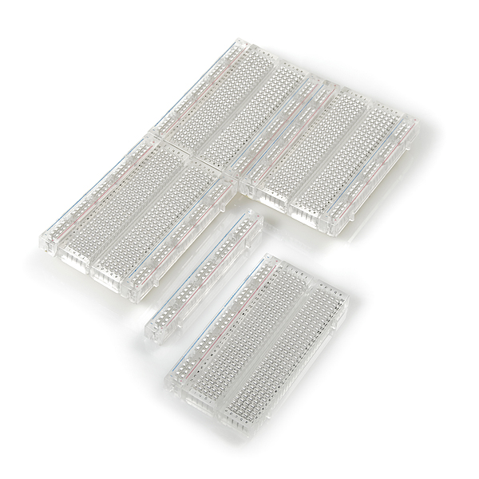
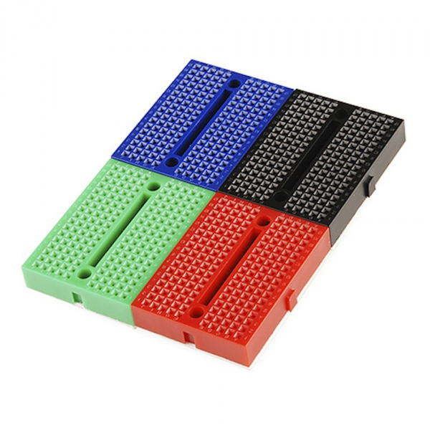
Breadboards are like Legos!
Breadboards
Many breadboards have little nubbins and slots on the sides, and some even have them on the tops and bottoms. These allow you to connect multiple breadboards together to form the ultimate prototyping surface.
[source: sparkfun.com]

Slide 54
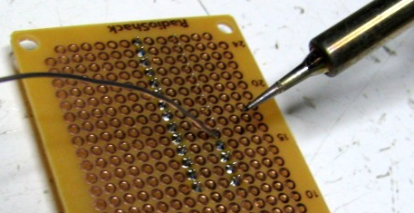
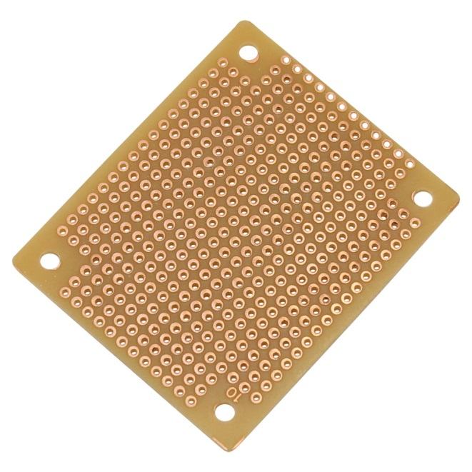
Breadboards vs. perfboards
Breadboards
Typically, you start prototyping on a breadboard but then switch over to something like a perfboard once your design is starting to solidify or you want something more permanent. Perfboards require soldering.
!=
Breadboard
Perfboard
[source: https://learn.adafruit.com/collins-lab-breadboards-and-perfboards/transcript,]

Slide 55
Breadboards vs. Perfboards
Some perfboards have the same connections and hole spacings as a breadboard
[source: https://learn.adafruit.com/collins-lab-breadboards-and-perfboards/transcript,]

Slide 56
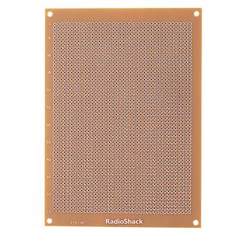
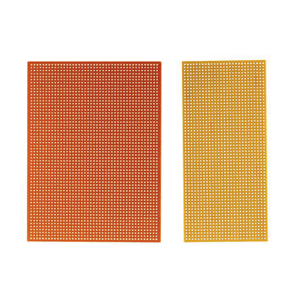
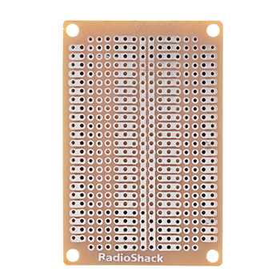
Perfboard Variety
There are lots of different kinds of perfboards with different pre-wired connections and sizes
[source: https://learn.adafruit.com/collins-lab-breadboards-and-perfboards/transcript,]

Slide 57
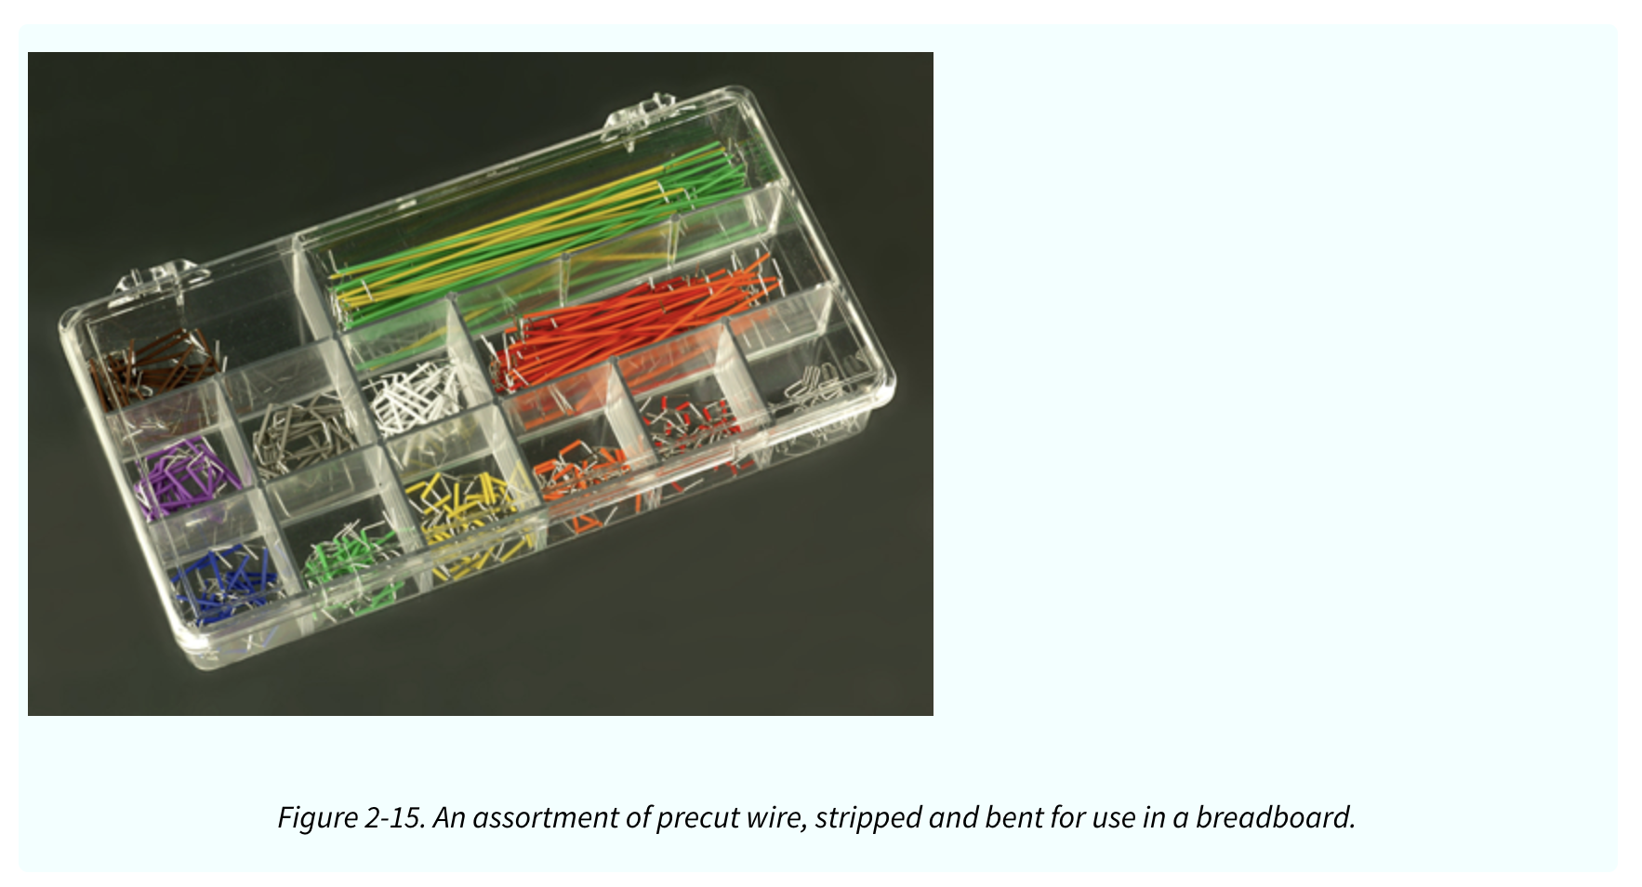
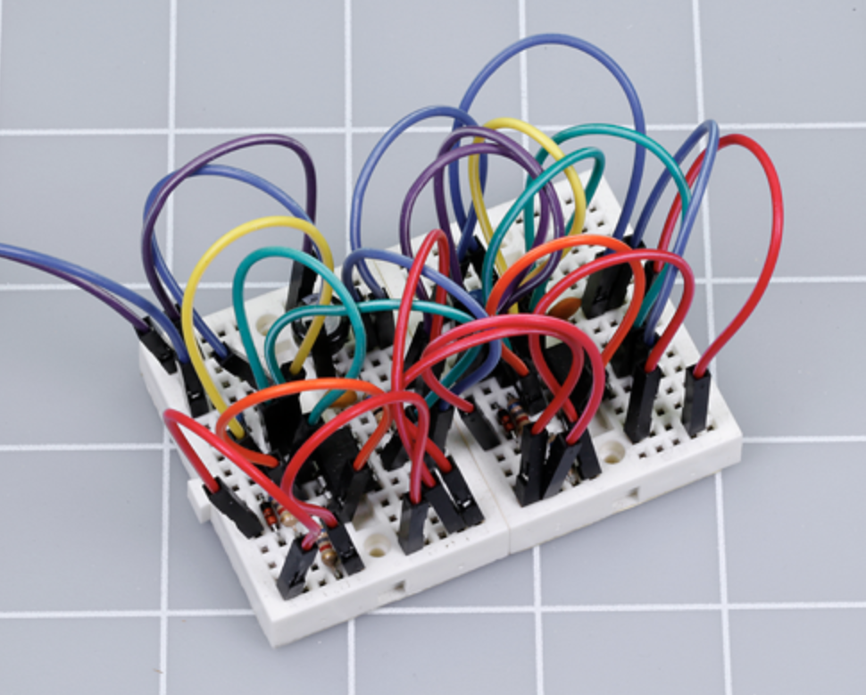
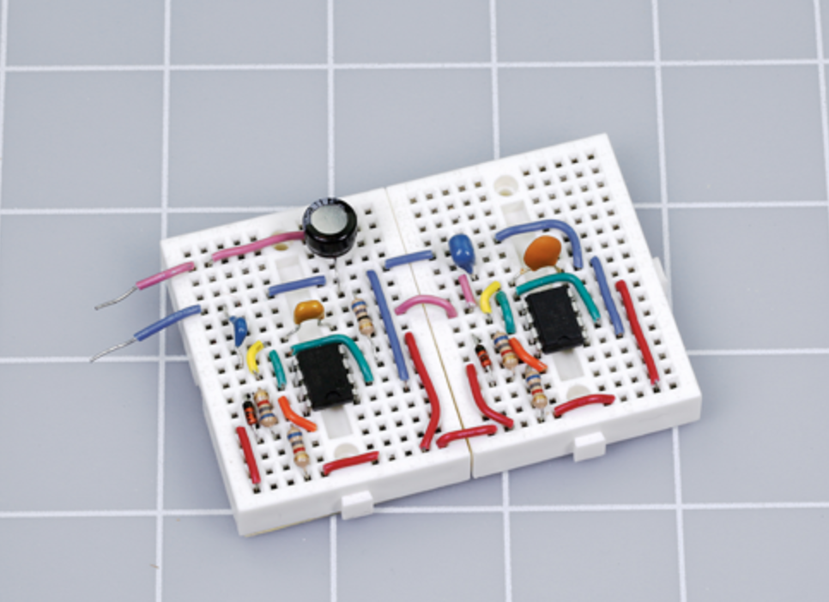
Notes:
https://learning.oreilly.com/library/view/make-electronics-2nd/9781680450255/ch02.html#SECTION_TWO

